Slide 1


DEPARTMENT OF COMPUTER SCIENCE AND ENGINEERING
CottonCare AI: Smart Cotton Crop Disease Detection and Farmer Advisory System
MR.Dr.B.L.BalaKumar
ASSOCIATE PROFESSOR,
DEPT. OF CSE
Tharun.K(230701523)
Madhan Kumar T (230701518).

Slide 2
INTRODUCTION
Cotton is an important agricultural crop, but its production is significantly affected by various diseases that can reduce crop quality and yield. Farmers, especially those in rural areas, may face difficulties in identifying diseases at an early stage due to limited access to agricultural experts and internet-based tools. Early and accurate disease identification is therefore important for taking timely preventive and corrective actions.
CottonCare AI is proposed as a smart, farmer-friendly system that uses image processing and deep learning to identify cotton crop diseases from leaf photographs. The system provides disease information, symptoms, recommended solutions, and preventive measures.

Slide 3
PROJECT OVERVIEW & OBJECTIVES/SCOPE
OBJECTIVE:CottonCare AI is a smart agricultural application designed to help cotton farmers identify major crop diseases using photographs of affected leaves. The system aims to provide simple and understandable information about the detected disease, including its symptoms, possible spread, recommended solutions, and preventive measures. The application is designed with an offline-first approach, allowing farmers to access important disease-related information even when internet connectivity is limited.
SCOPE:The project focuses specifically on cotton crop disease detection and farmer advisory. It includes collecting and labeling cotton disease images, training and comparing CNN-based models, selecting the best-performing model, and integrating the model into a mobile application using TensorFlow Lite for offline inference.

Slide 4
EXISTING SYSTEM
Currently, cotton disease identification is mainly done through manual observation by farmers or agricultural experts. Farmers identify diseases based on visible symptoms such as leaf spots, curling, yellowing, and wilting, which can sometimes lead to incorrect or delayed identification.
Some existing digital and online applications provide crop disease detection, but many require internet connectivity and may provide limited information beyond disease identification. They may also lack simple, farmer-friendly recommendations and preventive measures, making it difficult for farmers to take timely action.

Slide 5
PROBLEM STATEMENT
Cotton farmers often face difficulties in identifying crop diseases accurately at an early stage due to limited agricultural expertise and access to specialists. Manual identification based on leaf symptoms can be time-consuming and may lead to incorrect decisions, resulting in disease spread and reduced crop yield.
Therefore, there is a need for a simple and offline AI-based system that can identify cotton diseases from photographs and provide farmers with understandable information about the disease, recommended solutions, preventive measures, and possible disease progression.

Slide 6
METHODOLOGY & SYSTEM ARCHITECTURE
Methodology:The proposed CottonCare AI system follows a systematic approach for detecting and managing cotton crop diseases. First, images of healthy and diseased cotton leaves are collected and labeled to create a disease dataset. The images are then preprocessed and used to train multiple CNN-based deep learning models. The models are evaluated based on accuracy and performance, and the best-performing model is selected. Finally, the trained model will be converted into TensorFlow Lite format and integrated into the application for offline disease detection. The system provides the detected disease along with symptoms, recommended solutions, preventive measures, and disease progression information.

Slide 7
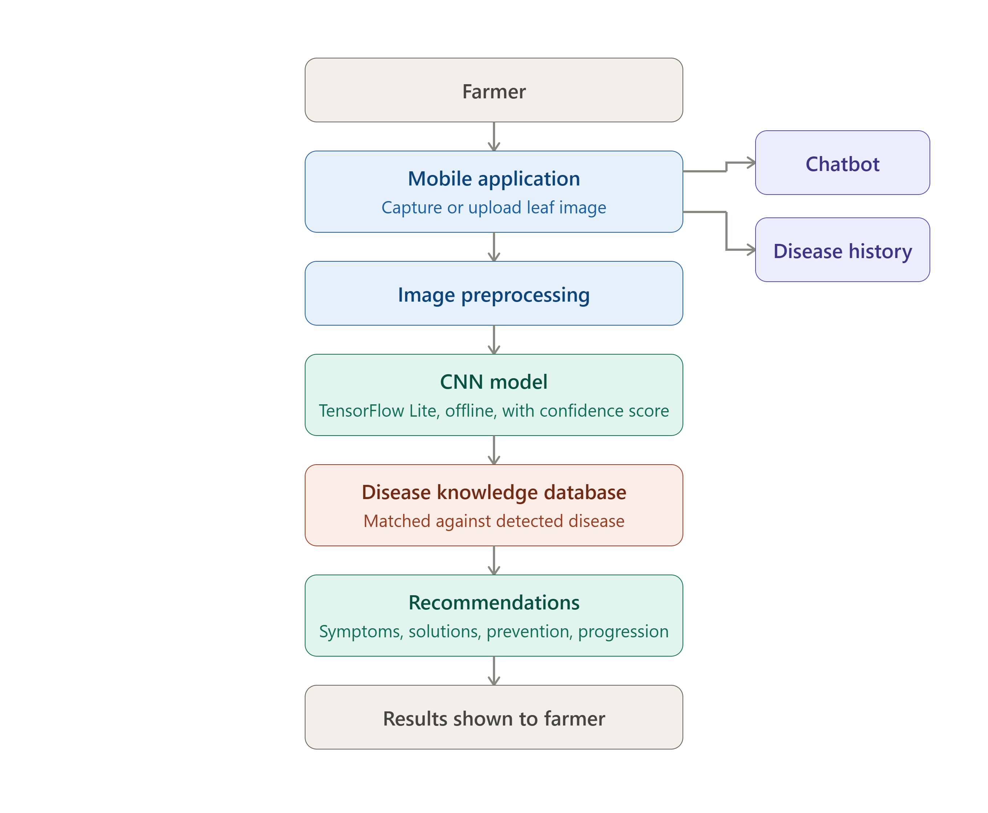
SYSTEM ARCHITECTURE (contd.)

Slide 8
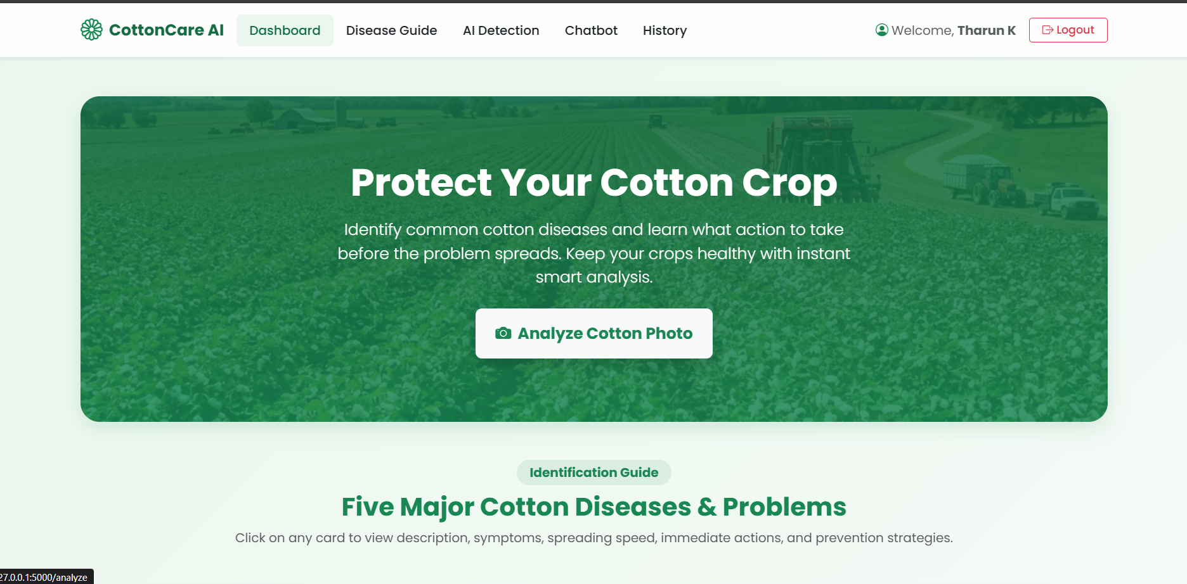
GLOBAL ADMIN CENTER

Slide 9
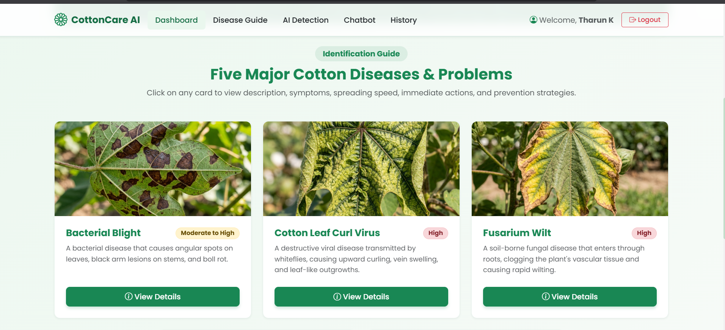
Major cotton Diseases & Promblem

Slide 10
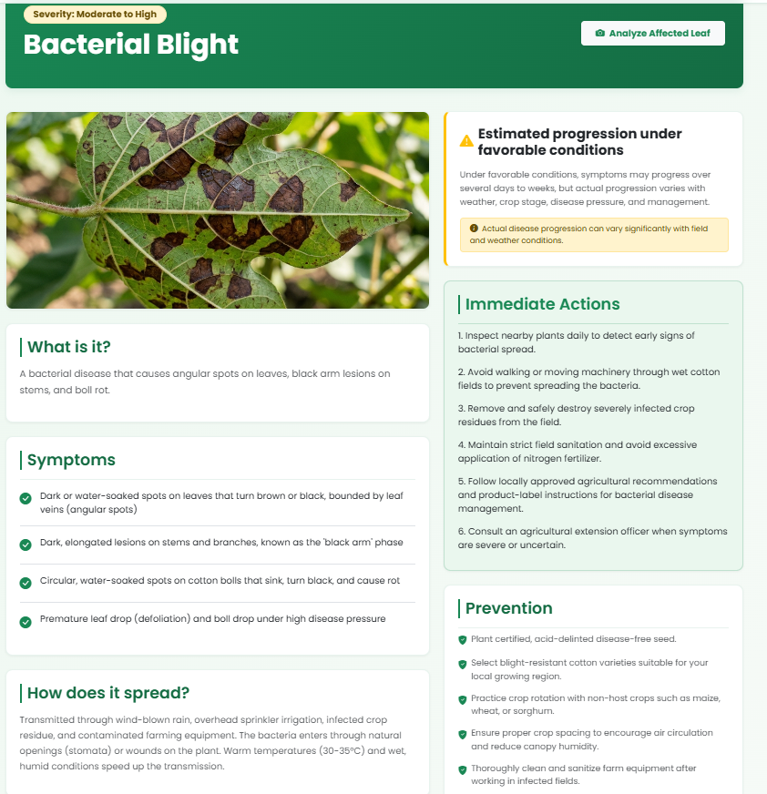
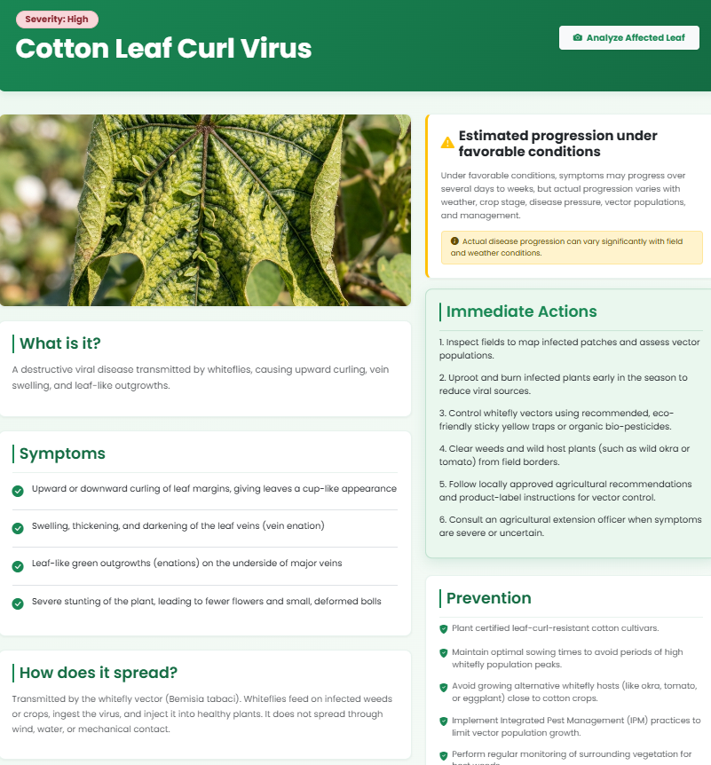
Disease guide

Slide 11
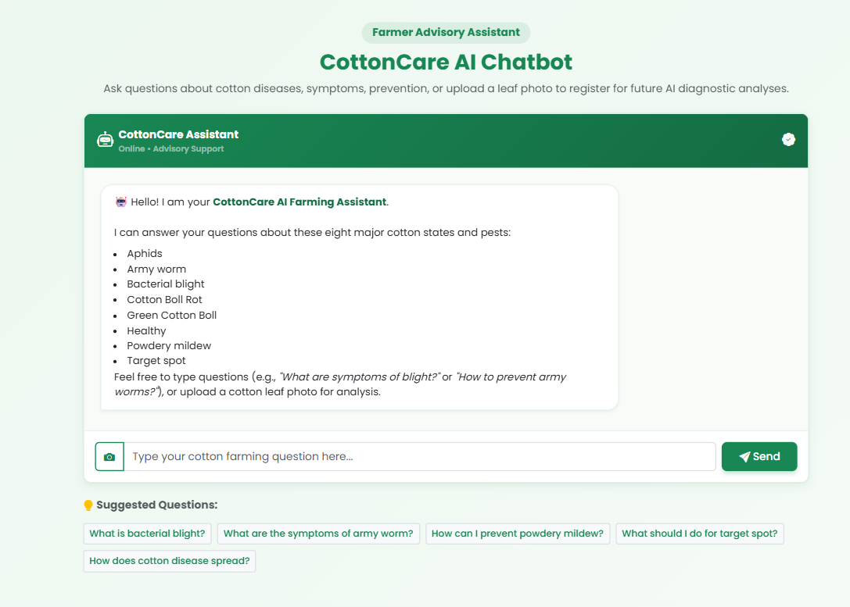
Farmer Advisory Assiatant

Slide 12
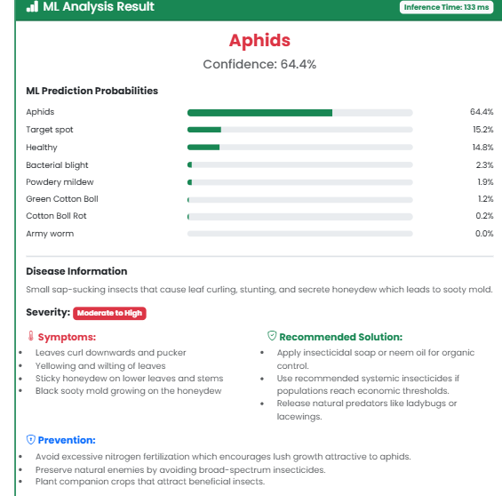
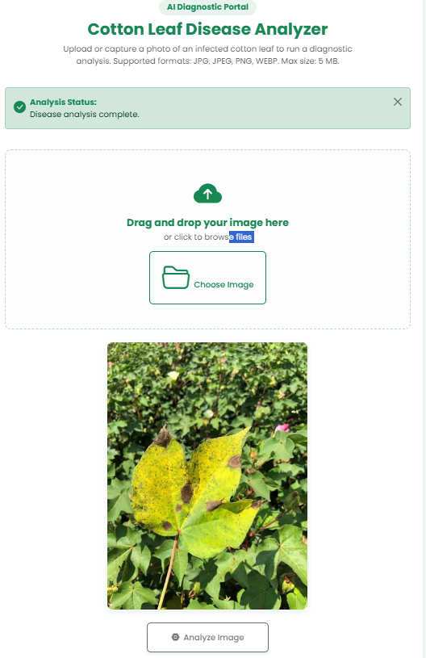
AI Detection Portal

Slide 13
LITERATURE SURVEY
Author(s) / Year | Title of the Paper | Methodology / Approach | Inference
Khan et al. (2022) | Cotton Leaf Disease Detection Using Instance Segmentation | Mask R-CNN with transfer learning for cotton leaf disease detection | Achieved about 94% training accuracy and demonstrated the usefulness of deep learning for practical cotton disease detection.
Shahakar, Likhare, Wakode et al. (2023) | Cotton Leaf Disease Classification using Deep Convolution Neural Network with Explainable AI | Lightweight deep-learning framework for cotton leaf disease recognition | Demonstrated that computationally efficient deep-learning approaches can be used for cotton disease recognition.
Ferentinos et al. (2021) | Identification of Cotton Leaf Lesions Using Deep Learning Techniques | GoogleNet and ResNet50 CNN models for field-based cotton leaf lesion detection | ResNet50 achieved 89.2% precision, showing the potential of CNNs for field-level cotton disease monitoring.
Hassan et al. (2021) | Cotton Leaf Diseases Recognition Using Deep Learning and Genetic Algorithm | ResNet101 transfer learning, feature fusion, data augmentation and Genetic Algorithm | Feature selection and deep learning improved the recognition of different cotton leaf diseases.
Islam et al. (2023) | A Deep Learning Model for Cotton Disease Prediction Using Fine-Tuning with Smart Web Application in Agriculture | Fine-tuned VGG16, VGG19, InceptionV3 and Xception models | Xception achieved 98.70% accuracy and was integrated into a smart web application for cotton disease prediction.
Johri et al. (2024) | Advanced Deep Transfer Learning Techniques for Efficient Detection of Cotton Plant Diseases | EfficientNet, Xception, ResNet, Inception, VGG, DenseNet and MobileNet | EfficientNetB3 achieved 99.96% accuracy, showing strong potential for automated cotton disease detection.

Slide 14
Thank You

